Slide 1

CAKE Presents PIE
By: Colin Harrison, Christian McMurtrie, Timothy Nakhisa, and Zachary Rivera
Notes:
Introductions: Hi my name is ...
Colin: ... and we make up the CAKE group. We are working on a website that we plan to call PIE.

Slide 2
Introduction
CAKE Group (Computer Applications Knowledge and Experience)
Colin Harrison: Documentation/Dev
Christian McMurtrie: Research/Dev
Tim Nakhisa: Version Control Manager/Dev
Zac Rivera: Scrum Master/QA
Notes:
Colin: CAKE stands for Computer Applications Knowledge and Experience and PIE is an acronym for Personal Interactive Expeditions. We have been working with our client Dr. Yvonne Chueh and our faculty mentor Dr. Ed Lulofs to develop a website that will aid the elderly community that is facing social isolation. This site will promote social activities and outings by allowing members to easily plan activities with other members and possibly, in the future, with volunteers and donors. The simple design should allow easy navigation of the site, easy-to-use scheduling tools, and more.

Slide 3
Real World Application
Help Socially Isolated Individuals
Simple Design
Easy to use Interface
Promote Healthy Lifestyle

Slide 4
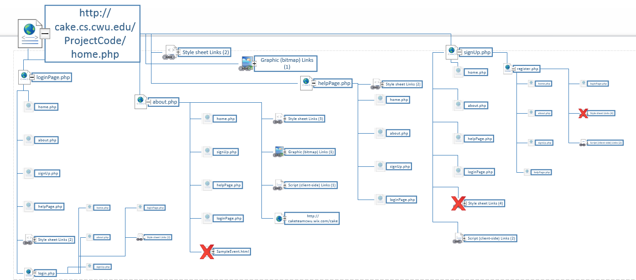
Architectural Design
Notes:
Our team website was created using a free website editor called wix. All images are royalty-free. The "About" section explains who our group is, what we are working on, and why. The "Project" tab has a brief explanation of our project. It also has a drop down menu that is activated by hovering over "Project". This allows you to view the "Agendas" tab, which shows our client, faculty mentor, and group meetings. The "Repository" tab includes a link our team's repository, links to individual sections of the repository, and a list of past commits. Under the "Scheduling" tab you can see what each of the team members is currently working on as well as lists of major upcoming tasks and completed tasks. There is also a list of "forseen difficulties" that shows some possible problems that we may run in to over the course of the project. Finally, the contact tab contains pictures of each of our group members, our current roles, and some of our contact information. The message box below is linked to our group gmail account, so any messages sent will be accessible by any member of the group.

Slide 5
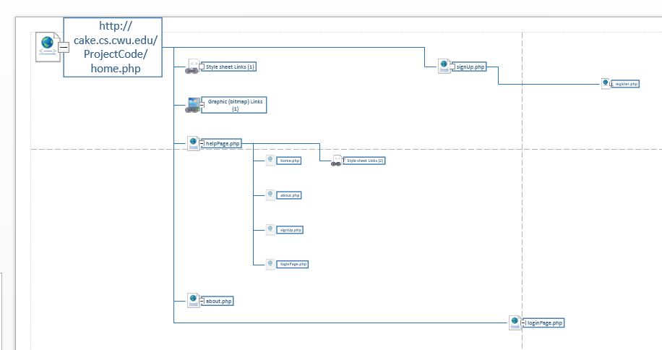
Module Example
Insert example

Slide 6
Module design
Used HTML, PHP, SQL, CSS, and JavaScript
Developed in SublimeText2 and Notepad++
Windows and Apple operating systems
Server hosting website for testing

Slide 7
Development Strategy
Kanban Method
Agile Process
Flexibility with client and requirements

Slide 8
User Interface Rules
Demonstration
Consistent templates
Demographic in mind for easy usability
Large buttons and text
Buttons and links in consistent areas

Slide 9
First Testing Phase
Manual testing – CWU test server
Look and feel
Functionality
Multiple platforms (non-mobile browsers)
Database tests
Notes:
Our first stage of testing is manual testing. This means that our group members are manually testing the site during development. Right now we have a test server set up, but it is only available in Hebeler Hall. In our next iteration, we plan to finish this phase of testing and find a suitable server online. Our testing entails checking the site for the look and feel as well as checking for functionality. We want to make sure our site has a simple yet elegant appearance. To do this, we have created a lot of separate pages to make the site more easily navigable while keeping a similar template for each page in order to allow the user to work with a familiar layout. We have some ideas for changes. For example, rather than using multiple pages while logged in, we are considering using pop up windows to edit a user’s description, add photos, and more. This would allow for a “prettier” layout that makes the user feel like they aren’t being redirected too frequently. Testing functionality is more important to us because we need to ensure that our site works correctly on any platform the user might be using. We have not developed a mobile site, but we have been testing on common browsers on both Windows and Mac operating systems. Furthermore, we have been creating, editing, and testing different tables in our database.

Slide 10
Second Testing Phase
Hosting online
Working with test groups
Peer testing
Elmview workers
Sociology department
Notes:
As I stated in the previous slide, we plan to have the site hosted online for our second phase of testing. This will allow us to test on computers outside of the CS building, so we can test different browsers, systems, and users. We plan to start with peer and other testing when the site is hosted and manual testing is finished. Hopefully some of the students in here might be willing to help. We will also be testing different people that might have some experience with something similar to potential users. For example, we have some contacts that work for Elmview, a non-profit organization concerned about people with developmental disabilities. Also, we have some contacts in the sociology department that may be willing to help.

Slide 11
Demonstration

Slide 12
Conclusion – Past Tasks
PIE’s goal is to promote healthy social activities
Completed tasks:
Creating easy-to-navigate pages
Ex. Home, About, Help, Register/Login, Profile/Viewed Profile
Hosting the site on a testing server
Storing and retrieving user and event information
Ex. Tables for User, Events

Slide 13
Conclusion – Future Tasks
Future tasks:
Adding photo upload, charts, calendar, and event slider
Finishing connection queries
Online hosting
User testing and updates

Slide 14
QUESTIONS?

